Slide 1


2024 Annual Report
Notes:
Detective has spoken with 5 other universities. Most of the Universities reported having a counter protest during Charlie Kirk’s talks. Incidents reported at those universities from nothing all they way to a full on riot that kept police on scene for 12 hours. UC Davis was the riot and it cost them around $400,000 in damages and manpower. Events ranged from 20 people all the say to 1000 showing up.

Slide 2
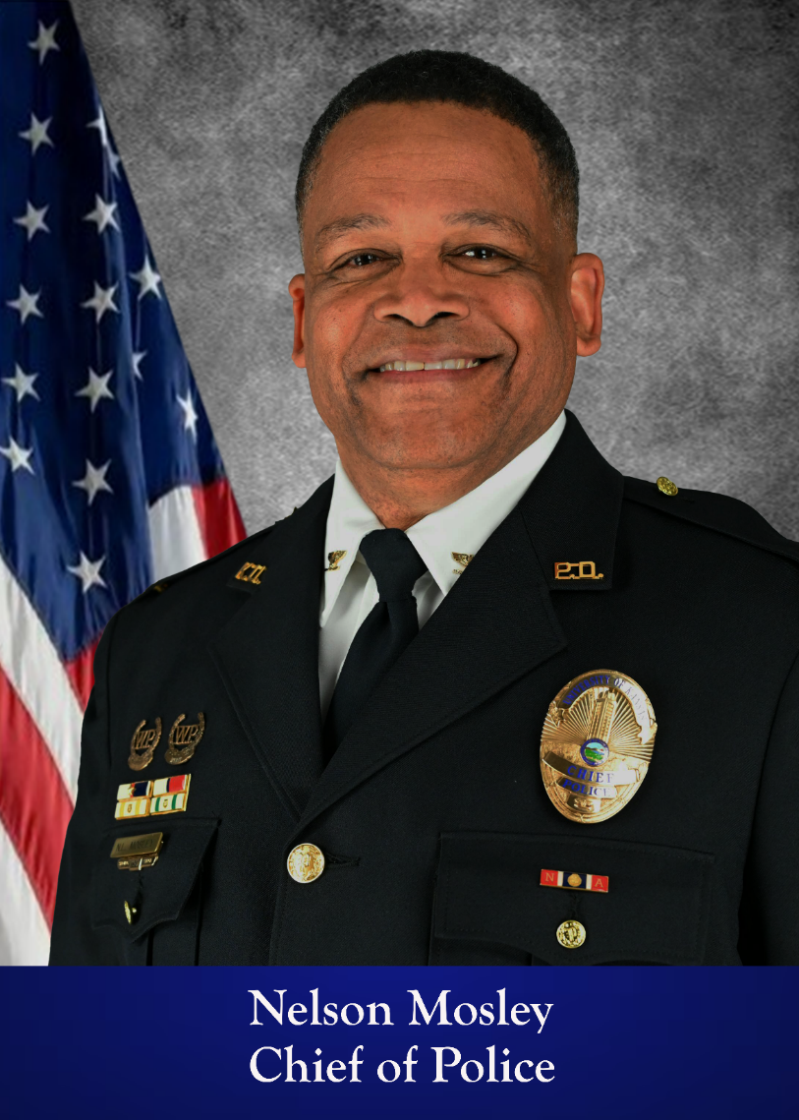


A Message from the Chief of Police
Our mission is to provide a safe and secure environment through education, collaboration, and service. My commitment to you is that we will continually work openly and transparently to build and enhance relationships within the KU community, one personal connection at a time.
The KU Police Department has a community policing philosophy involving community engagement, innovative problem solving, transparency, and accountability. Our goal is to provide exceptional public safety services in a fair and just way while treating everyone with dignity and respect.
I welcome input on our services and community interactions, and I encourage you to follow us on social media for more information about our agency, crime prevention tips, available resources, and other educational community safety facts.
Rock Chalk!
Chief Nelson Mosley

Slide 3


Slide 4

Total Commissioned: 35
Total Security: 17
Total Emer. Comm.: 9
Total Administrative: 6
Total Employees: 67
Chief of Police (1)
2024 Organizational Chart
Administrative Associate (1)
Deputy Chief (1)
Administrative Assistant (1)
Emergency Management Division
Associate Director (1)
EM Specialist (1)
Investigations/Support Services Division
Captain (1)
Patrol Division
Captain (1)
Specialty Unit
Honor Guard
Specialty Unit
Range
Emergency Communications
Manager (1)
EC Supervisor (1)
EC Specialists (8)
Community Engagement/Training
Sergeant (1)
Detectives (2)
Police Officer (1)
Investigations Sergeant (1)
Detectives (2)
Video Review/Security
Manager (1)
Security Officers (6)
Spencer 5 – Mags 1
Part Time Students
(3-10)
Patrol/Security
Sergeants (6)
Police Officers (18)
Security Officers (8)
Evenings/Nights
Security
Edwards Campus
Supervisor (1)
Officers (2)
3/18/2024

Slide 5
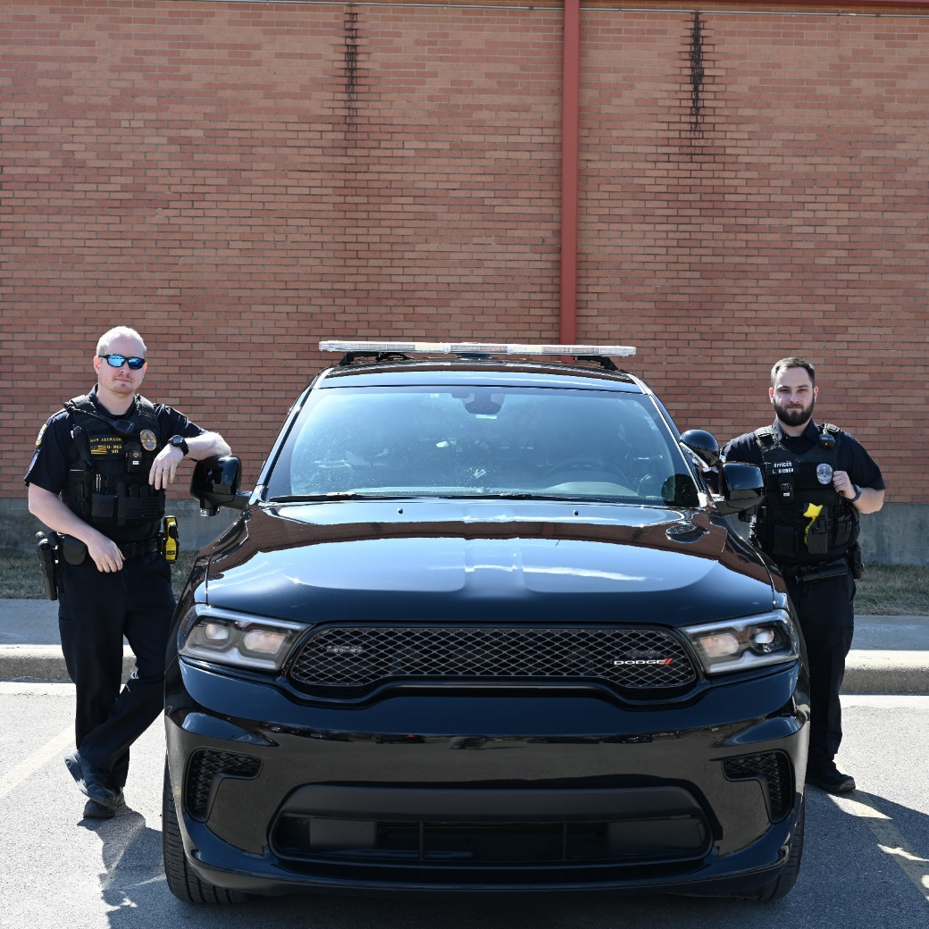
2024 Accomplishments at a Glance
Expanded Peer Support Capabilities
Increased Upward Mobility Opportunities
Advanced Leadership Training
Over 4,000 hours of Certified Field Training
Ten New Police Officers Hired
Work Towards KLEAP Accreditation
Red Dot Firearms Sighting Systems
StopSticks in All Patrol Vehicles
Encrypted Radio System Upgrade in the Emergency Communications Center
Sgt. Jackson and Officer Bieber Preparing for Field Training

Slide 6
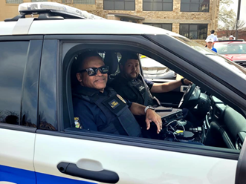
Task Force on Community Responsive Public Safety
In May of 2021, the Chancellor of the University of Kansas appointed a Task Force on Community Responsive Public Safety.
Recommendations were made in three categories:
Responses to Behavioral Health Crises
Officer Conduct
Advisory and Oversight
As of the end of 2024, the University of Kansas Police Department had completed their work in meeting the recommendations of the task force.
Chief Mosley and Detective Freeman on Patrol

Slide 7
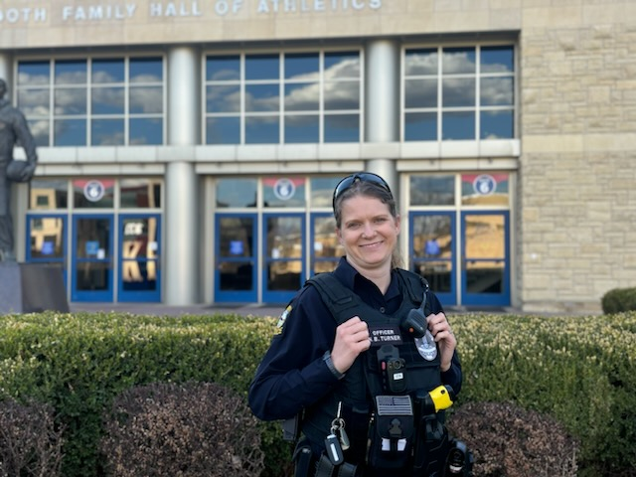
Strategic Plan Accomplishments
The 2022-2026 KU Police Department Strategic Plan contains several goals and strategies to drive progress within the agency. Goals include:
Improvements in community policing
A retention plan that creates upward mobility opportunities, a healthy workplace culture, and adequate pay
A recruitment plan designed to attract qualified candidates who reflect our community
An efficient, community oriented department structure
Technology Investments to enhance a safe and secure environment for personnel and the community
Officer Turner in Front of Allen Fieldhouse

Slide 8
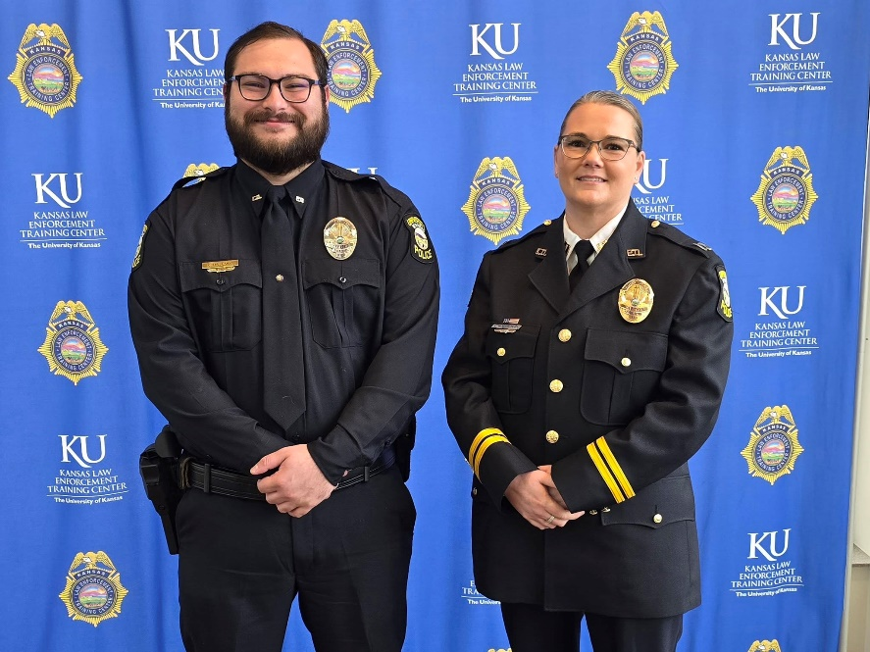
Strategic Plan Accomplishments
In 2024, major steps were taken in realizing the strategic plan.
KUPD continued to build relationships with groups and organizations on campus and within the Lawrence community.
Two Captains and a Sergeant were added to create additional upward mobility opportunities. We continued to make strives in competitive pay.
Supervisors attended advanced leadership training.
Peer support personnel were added and new health and wellness resources, including a specialized phone application, were implemented.
Changes were made to the organizational structure to increase efficiency and accountability.
10 new police officers were recruited.
Officer McAloon with Captain Golightley at Officer McAloon’s KLETC graduation.

Slide 9
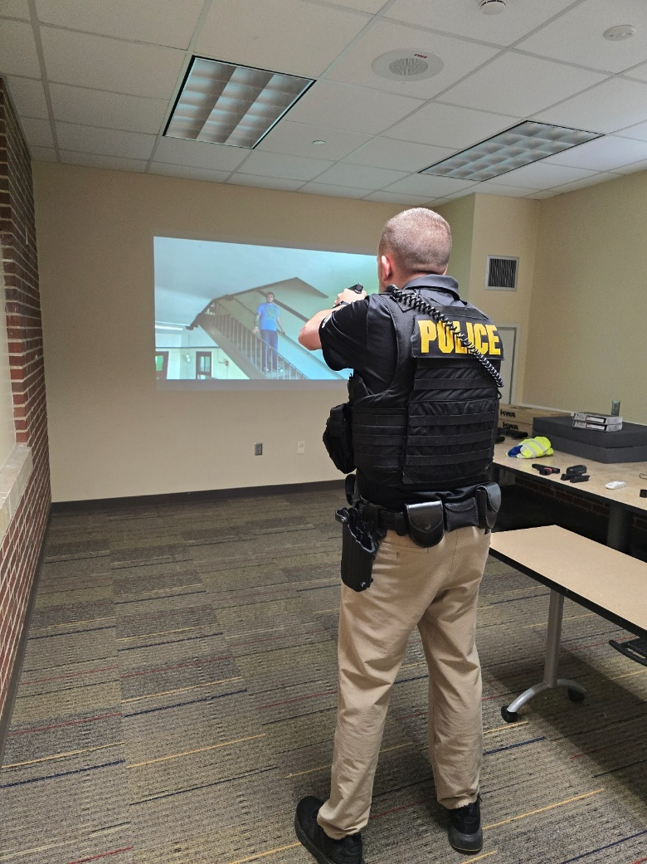
Active Shooter Training and Exercise
The KU Police Department conducted a series of active threat-related trainings in 2024 that culminated in a full-scale exercise in June.
In February, officers received training in the use of breaching tools.
In April and May, officers received classroom training in active threat responses that included basic movement drills.
In early June, officers received active threat training in short, live scenarios as well as utilizing the use of force simulator.
In late June, officers took part in a full-scale exercise that included a real-time scenario including utilizing communications, Emergency Management, and on-scene coordination between arriving units.
Sgt. Ridgway on the Use of Force Simulator

Slide 10
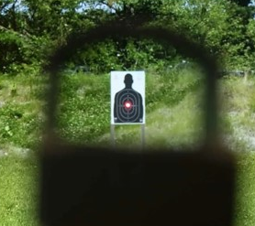
Red Dot Sighting System for Service Handguns
KUPD obtained new service handguns for all officers, including a red dot sight system.
This type of system has been shown to produce higher accuracy.
The system also allows officers to focus on the target, rather than the front sight, which could reduce the chance of misidentifying a threat.
The deployment of this system included training and re-qualification for all officers as a means of familiarization. All officers qualified and are proficient with the system.
All handguns were also equipped with a mounted light, which can increase accuracy in low-light situations versus a separate hand-held flashlight.

Slide 11
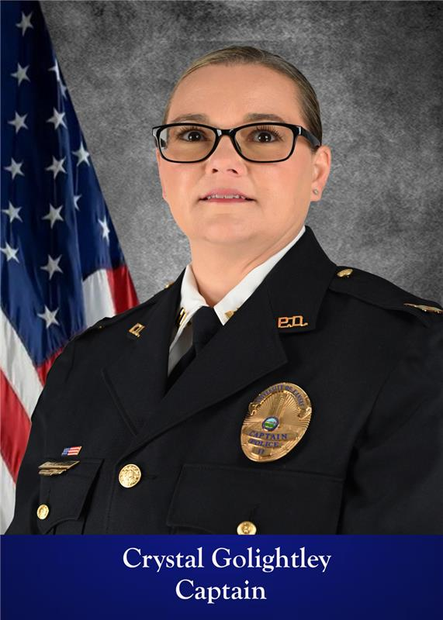
Patrol Division
The Patrol Division is headed by Captain Crystal Golightley who is responsible for Police and Security patrols, as well as CCTV monitoring and review.
Police Patrol
Enforce city, state and federal laws, and enforce University regulations.
Security Patrol
Patrol and secure buildings on the main KU campus and the Edwards campus.
Range
Maintain departmental firearms qualifications and proficiencies.
Video Review/Security
Monitor and review CCTV cameras.
Notes:
More icons available at:

Slide 12
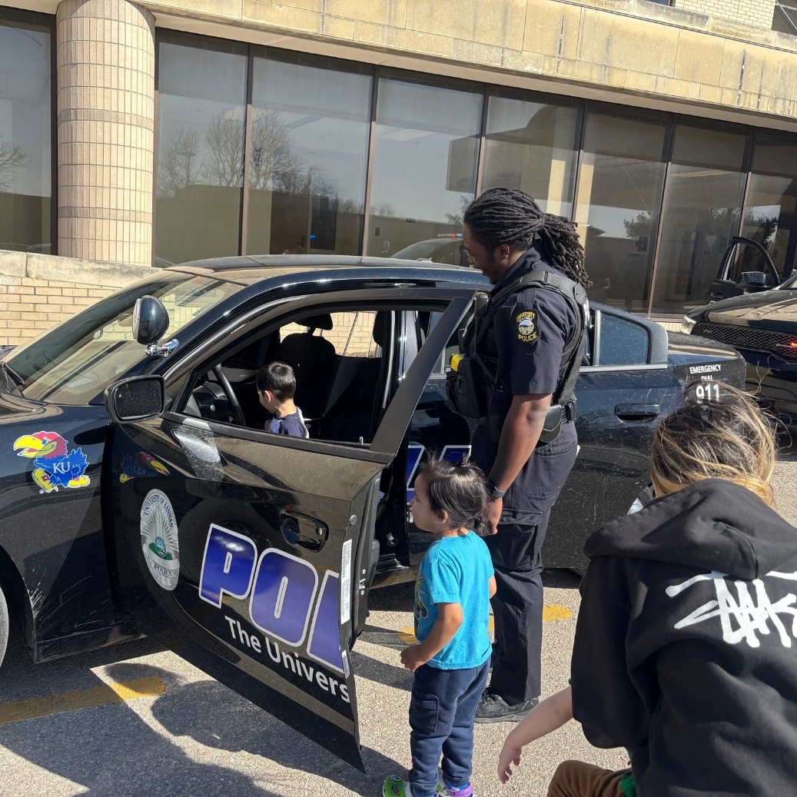



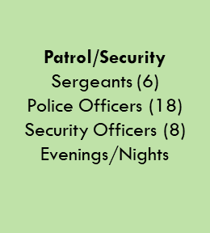
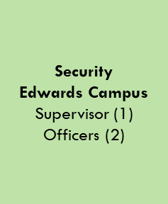
Patrol Division
Officer Harris Showing Children a Patrol Car

Slide 13
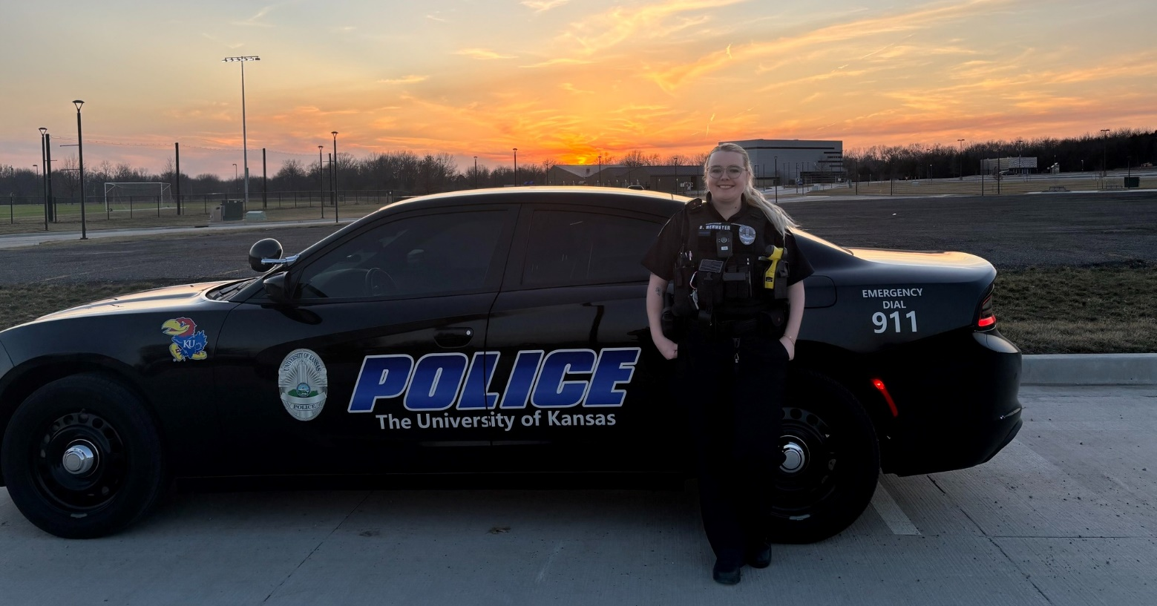
Patrol Division - Police
Police Officers within the Patrol Division respond to calls for service at the University of Kansas and its affiliated property 365 days a year.
The department is authorized a staff of 35 fully-commissioned officers who are certified by the Kansas Commission on Peace Officers’ Standards and Training. They respond to emergency calls including medicals and fires, enforce municipal and state laws, and investigate crimes and motor vehicle accidents.
Officer Wehmeyer at Sunset on Campus

Slide 14
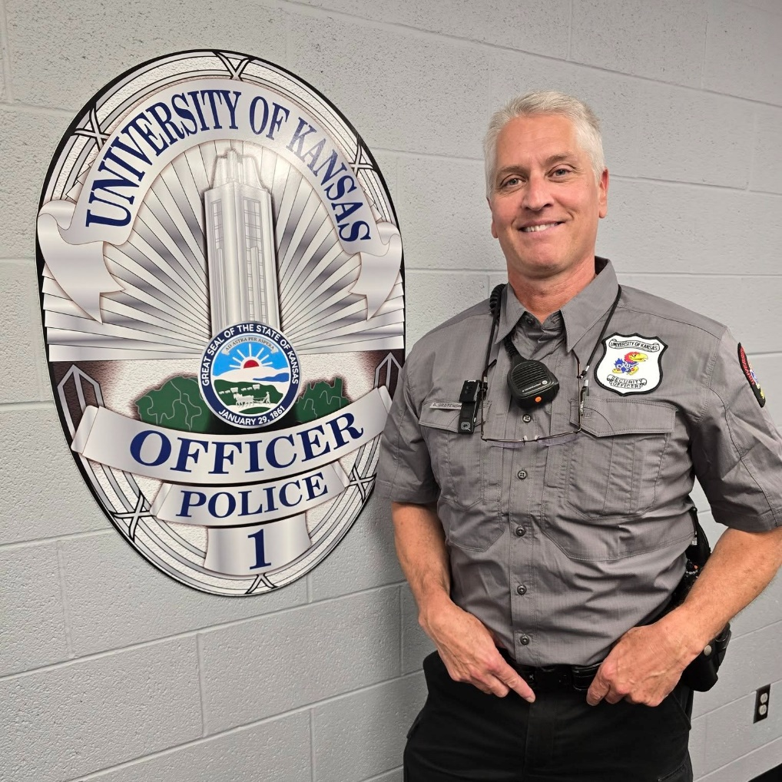
Patrol Division - Security
Security Officers patrol and secure 124 facilities at both the Lawrence and Edwards campuses, including Spencer Art Museum and KU Athletics.
Security services include locking and unlocking buildings, granting authorized individuals access to their offices, as needed, and searching for potential safety hazards.
In 2024, KUPD added a curriculum of twenty hours of required annual training in order to bolster the professional capabilities of our Security staff.
Security Officer Grotewohl Getting Ready for a Shift

Slide 15
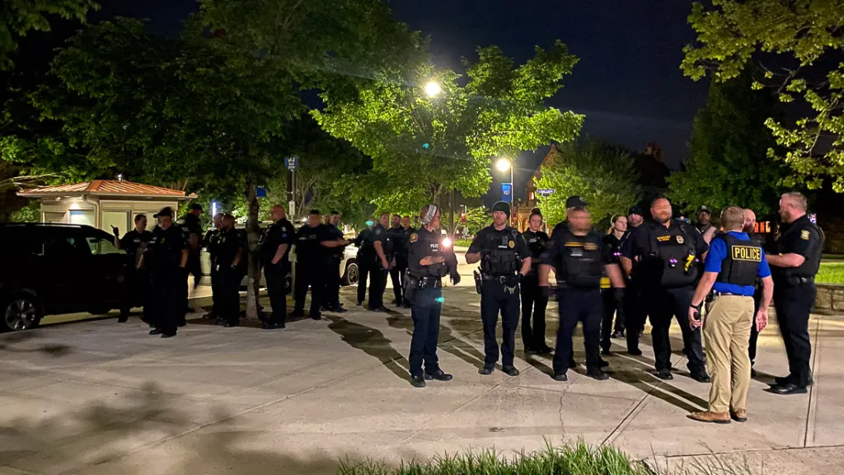
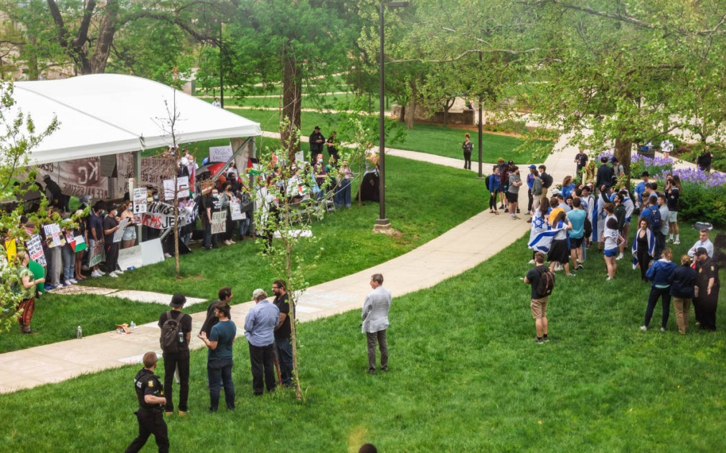
KUPD Significant Events and Cases
From May 1, 2024 through May 12, 2024, a series of protests occurred on the lawn of Fraser Hall. Five arrests were made. One individual was arrested for battery. One individual was arrested for interference for refusing to leave a tent when given a lawful order and three individuals were arrested for criminal trespass.
In, 2024, in response to growing issues related to unauthorized persons located in campus buildings, as well as an increase in theft and criminal damage to property cases, patrol began conducting strategic, directed checks of buildings that had been identified as hotspots. These checks resulted in a significant decrease in these crimes as well as a significant increase in the security of the affected buildings.
In 2024, campus experienced a surge in scooter and bicycle thefts. An investigation showed that a significant number of these cases were connected to a single individual. Thirteen cases were submitted to the Douglas County District Attorney’s Office, resulting in a felony charge against one individual.
Photos of protest from The Lawrence Times

Slide 16
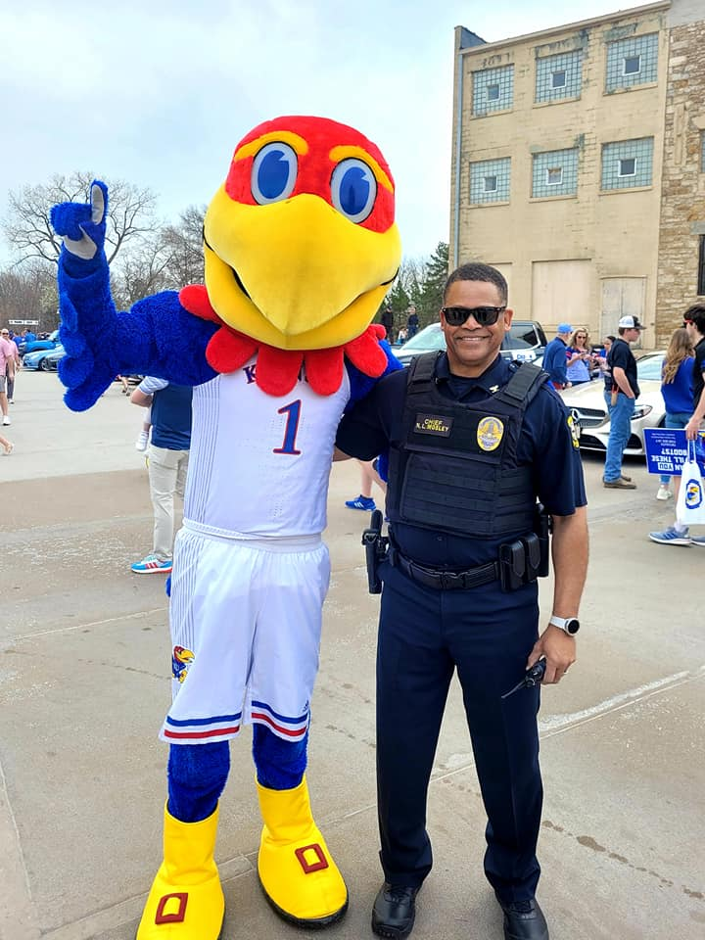
KUPD Operations Planning, Special Events, and Extra Patrols
KUPD develops operations plans for numerous events throughout the year. Some are regularly scheduled events, such as athletic competitions and commencement. Others are drafted in response to an identified concern or potential operational need.
In 2024, KUPD created 35 operations plans related to larger scale campus events including commencement, athletic venues, and operations plans written in response to other activities, such as protests.
In 2024, KUPD assigned officers to 312 special orders related to security requests by campus and non-campus organizations. These included athletic events and practices, events held by KU affiliates, and campus speakers.
Extra patrols are ordered in response to community concerns, identified crime trends, and other needs. In 2024, KUPD conducted 4,131 extra patrols.

Slide 17
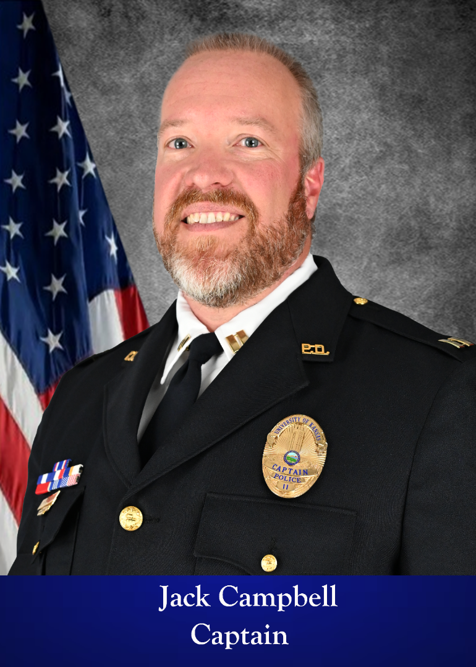
Investigations/Support Services Division
The Investigations/Support Division is headed by Captain Jack Campbell who is primarily responsible for case investigations and follow-up, community engagement and dispatcher/911 services.
Investigations
Conduct criminal and administrative investigations.
Community Engagement
Offer programming and outreach to the community and training to officers.
Emergency Communications
Enforce city, state and federal laws, and enforce University regulations.
Honor Guard
Enforce city, state and federal laws, and enforce University regulations.
Accreditation and Policy
Develop policies and procedures based on KLEAP standards.
Notes:
More icons available at:

Slide 18
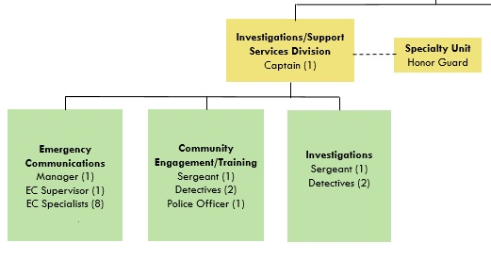
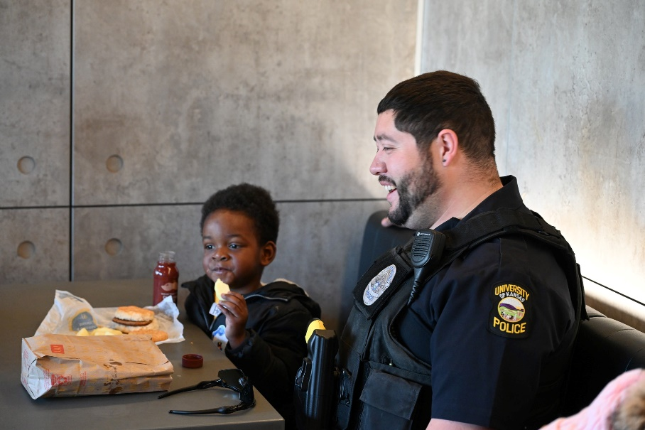
Investigations/Support Services Division
Detective Freeman Eats Breakfast with a Child
Notes:
More icons available at:

Slide 19
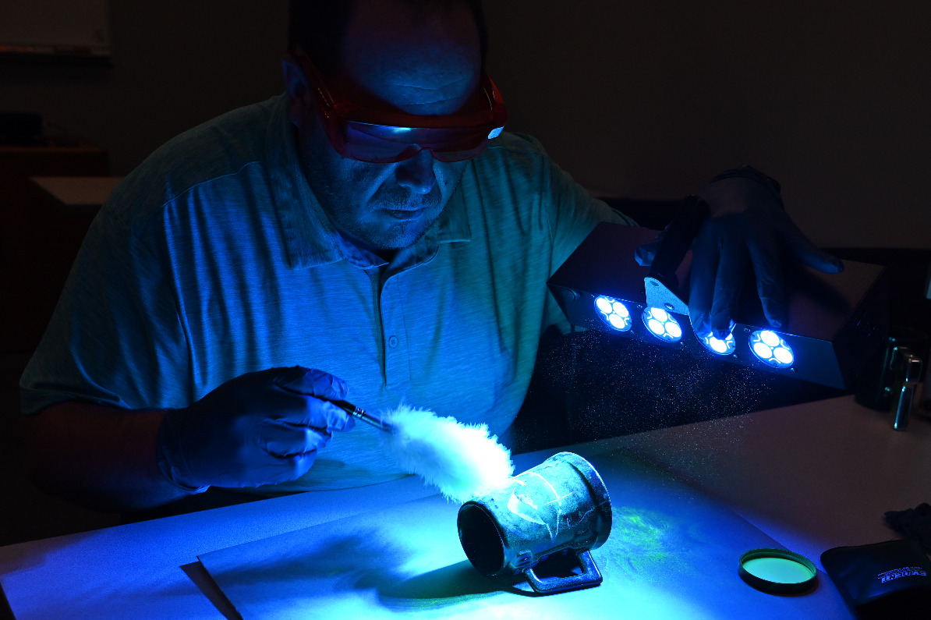
Investigations Section
The Investigations Section consists of two Detectives and a Sergeant.
Criminal Investigations
Investigation of violations of state and local laws
Evidence Custody
Tracking, storing, and disseminating evidence
Pre-Employment
Background investigation and candidate processing
Training and Coaching
Training officers in investigative techniques and reviewing cases for further follow-up
Liaison to Other Agencies
Working with other agencies to share intelligence and resources
Sgt. Carpenter Processing a Cup with Fluorescent Powder
Notes:
More icons available at:

Slide 20
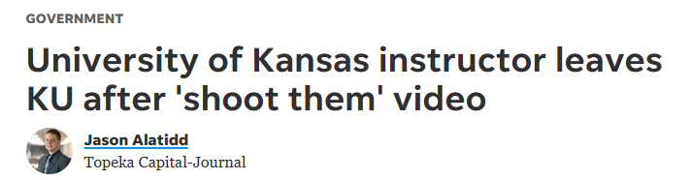
Investigations Section in 2024
Detectives investigated 46 cases and completed 44 background investigations as well as 38 checks for camera and lock system access.
In November of 2024, Detectives investigated an unattended death in a rural area owned by the University of Kansas. It was determined that the individual had committed suicide.
In 2024, the KU Police Department received several cases of suspicious emails, letters, or voicemails to various campus departments. Investigations performed follow-up to identify and contact senders, conduct threat analyses, and take steps to ensure the safety and security of the community.
In October of 2024, a professor made the comment “we can line all those guys up and shoot them” in a classroom. This resulted in numerous emails and phone calls from around the country. Detectives analyzed emails and calls for threats and coordinated with other jurisdictions to ensure the safety of the professor and the KU community.
Notes:
More icons available at:

Slide 21
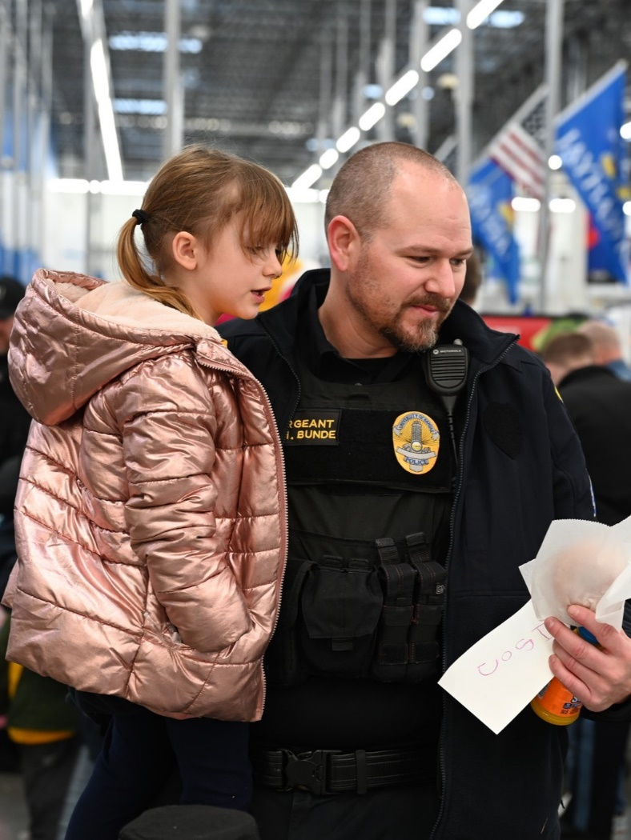
Community Engagement Section
The Community Engagement Section consists of an Officer, two Detectives, and a Sergeant.
Community Programs
Provides education and training for students, staff, and faculty
Investigations
Assists with criminal investigations and pre-employment backgrounds
Training
Coordinates Police Officers’ continuing education and field training
Equipment and Fleet
Maintains and issues departmental equipment
Lost and Found
Manages found property at the University of Kansas
Policy and Accreditation
Writes and reviews policies and monitors accreditation standards
Sgt. Bunde at the Annual TOYS Event
Notes:
More icons available at:

Slide 22
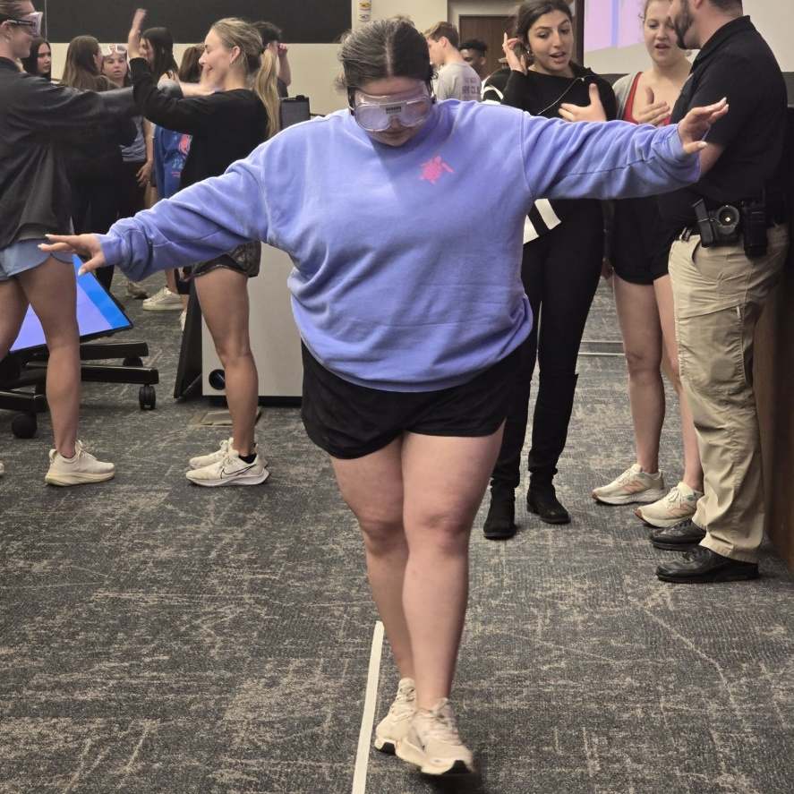
Community Engagement Section in 2024
The Community Engagement Section hosted 73 events in 2024.
The most requested program was Alcohol Education, a program that teaches the dangers of alcohol abuse and drunk driving. This is popular with the residence halls and utilizes Mario Kart and intoxication simulation googles.
Other presented programs included De-escalation, Active Threat, and Campus Safety. Community Engagement also provided training to Housing staff in advance of the school year.
Community Engagement was actively involved in pursuing accreditation for the department from the Kansas Law Enforcement Accreditation program. This program involves the development of policies and providing proof of compliance. This work continued in 2025.
A Student Takes Part in Alcohol Education Programming
Notes:
More icons available at:

Slide 23
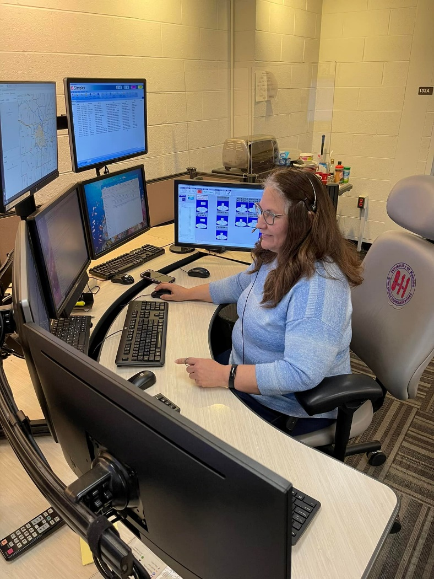



Emergency Communications Section
The Emergency Communications Section consists of eight dispatchers, a Supervisor, and a Public Safety Manager.
Calls for Service
Answers 911 and non-emergency calls
Information Technology
Maintains and issues all departmental networks and computer systems
Radio Traffic
Dispatches units and records their activity; Monitors other agencies
Persons and Property Checks
Checks people and property through databases for investigative connections, warrants, and other information
After-Hours Call Taking
Answers after-hours calls for Facilities and Parking
Alarm Monitoring
Receives fire, intrusion, and other alarms
Emergency Communications Supervisor Butler
Notes:
More icons available at:

Slide 24
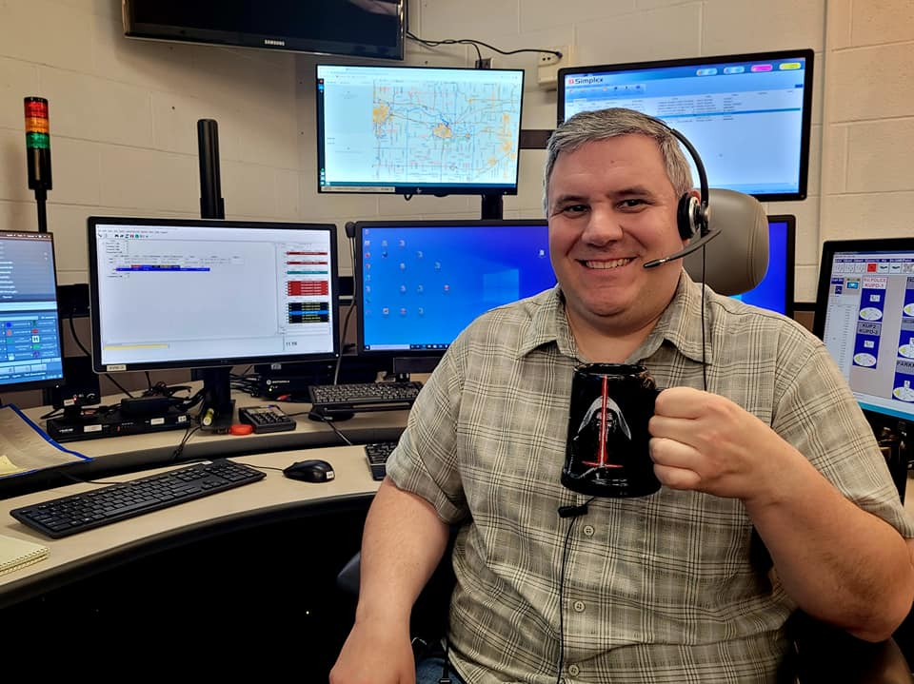
Emergency Communications Section in 2024
The KU Police Department Emergency Communications Center took 15,482 non-emergency calls and 1,136 emergency calls in 2024. Out of those 16,618 calls, 97.16% were answered in less than ten seconds.
Emergency Communications Officer Tomasich
Notes:
More icons available at:

Slide 25
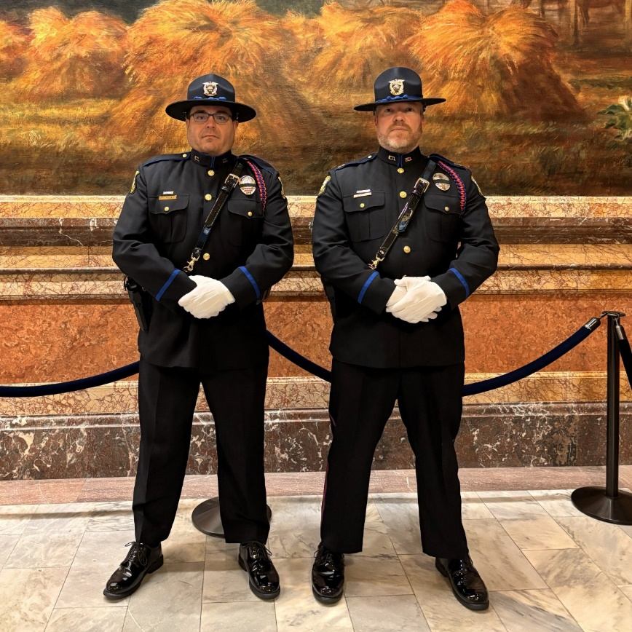
Honor Guard
The Honor Guard consists of trained ceremonial officers.
Color Guard
Perform maneuvers with flags and rifles for special events
Ceremonial Events
Represent the department and the law enforcement profession at various ceremonies
Funeral Response
Assist with law enforcement funerals as door guards, casket detail, cordons for families, graveside services, and other duties
2024 Overview
The honor guard served at special events including two KLETC graduations.
Sgt. Carpenter and Captain Campbell at the State Capitol
Notes:
More icons available at:

Slide 26
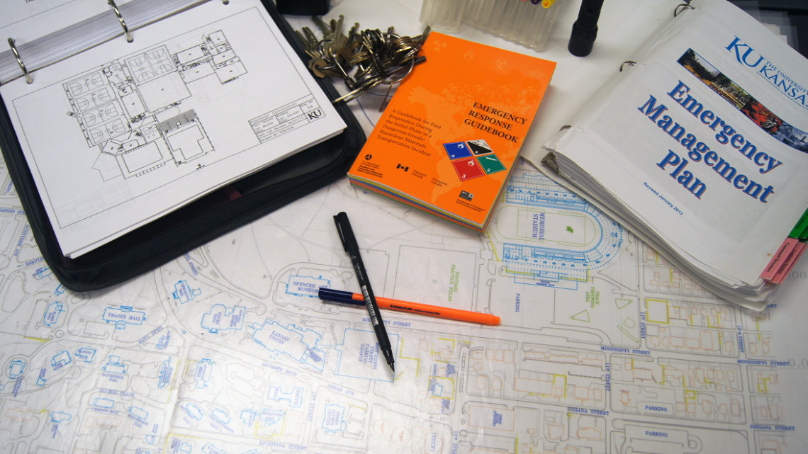
Emergency Management Division
The Emergency Management Division provides an integrated, comprehensive program for the KU community.
Emergency Preparedness
Presentations for student organizations & classes
Emergency Notifications
Coordination of public information and warning systems
Severe Weather
Awareness and monitoring
Preparedness Training
Douglas County Community Emergency Response Team (CERT) partner
Automated External Defibrillators (AEDs)
Program management and awareness
Notes:
More icons available at:

Slide 27
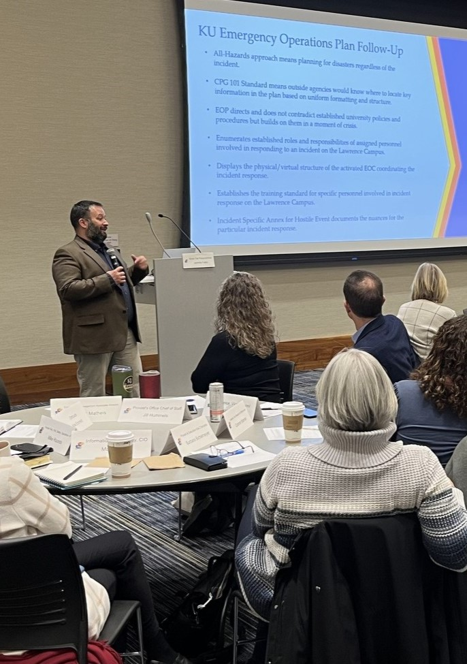
Emergency Management Division in 2024
Emergency Management completed the work to receive the National Weather Service Storm Ready designation for the Lawrence campus.
Emergency Management facilitated a cybersecurity exercise for executive-level personnel at the University of Kansas.
Emergency Management facilitated the addition of 36 new AEDs at the Lawrence and Edwards campuses.
Emergency Management, in conjunction with Facilities Planning and Development, Facilities Services, and Public Affairs conducted a campus-wide tornado drill. The KU Alert and Emergency Public Address System was tested.
Emergency Management participated in the planning for a full-scale active shooter exercise held in June.
Emergency Management Presentation
Notes:
More icons available at:

Slide 28
Use of Force
The KUPD Use of Force Review Board reviews all uses of force by KU Police Department employees, including those that are not reportable to the FBI. Uses of Force are posted to the Departmental website.
Total KUPD Uses of Force Reviewed in 2024: 6
Officers drew weapons in two use of force incidents. Both were related to felony traffic stops.
A Taser was drawn and pointed, but not deployed in one incident.
There were three incidents in which officers used physical force to get suspects into handcuffs. This force was limited to control tactics.
All uses of force were determined to be reasonable and within policy.
Notes:
More icons available at:

Slide 29
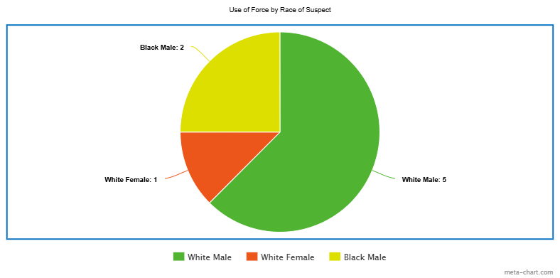
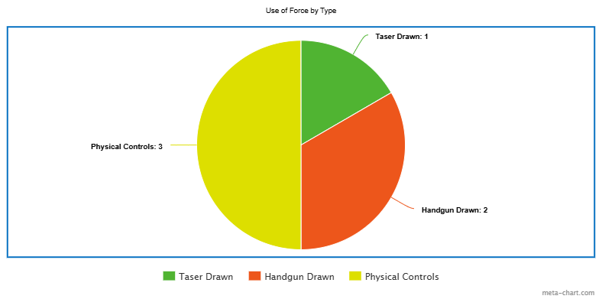
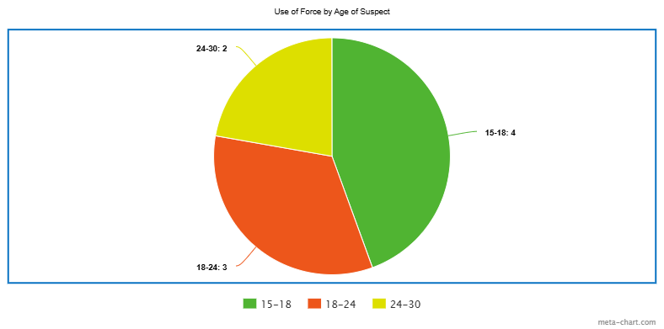
Use of Force Suspect Statistics
Top Left: Use of Force by Race of Suspect
Bottom Left: Use of Force by Age of Suspect
Top Right: Use of Force by Type
Notes:
More icons available at:

Slide 30
Vehicle Pursuits
The KU Police Department reviews all vehicle pursuits initiated by an employee of this agency.
Total Pursuits Reviewed in 2024: 1
A KUPD officer on routine patrol witnessed a reckless driver and pursued for a short distance before terminating.
The pursuit was reviewed and determined to be within policy.
Notes:
More icons available at:

Slide 31
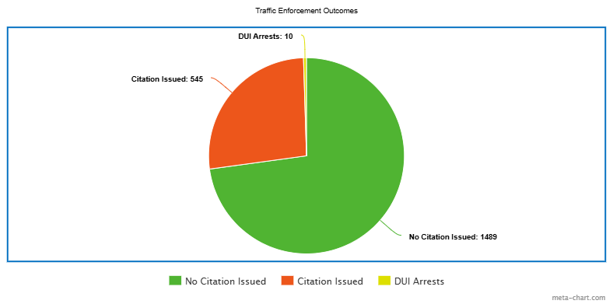
Traffic Enforcement
The KU Police Department conducts traffic enforcement on campus and campus-adjacent streets.
Total Traffic Stops: 2044
Citations/NTA’s Issued: 545
DUI Arrests: 10
Notes:
More icons available at:

Slide 32
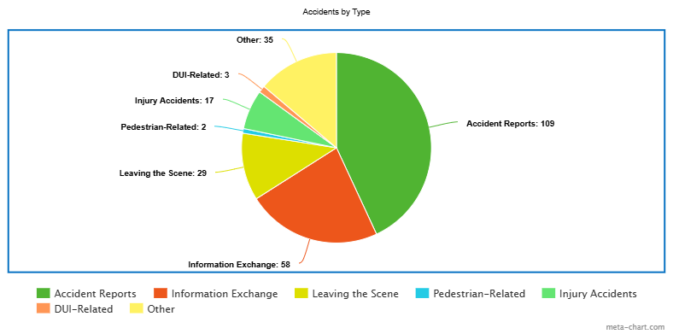
Traffic Accidents
The KU Police Department responds to and investigates accidents, both on public streets and on private property.
Total Calls to Vehicle Accidents: 253
Total accident reports written: 109
Parking lot information exchanges: 58
Leaving the Scene: 29
Pedestrian-related: 2
Injury Accidents: 17
DUI-related: 3
Other: 35
Notes:
More icons available at:

Slide 33
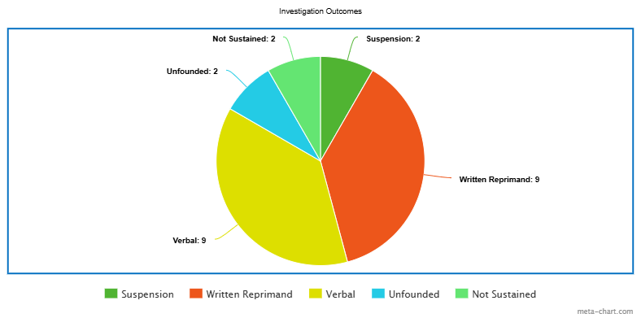
Summary of Administrative Investigations
The KU Police Department investigates all complaints received by the department, as well as any reported incidents of potential misconduct, violations of policy, or deviations from departmental procedures.
Total Administrative Investigations Initiated: 24
Internally Initiated: 19
Initiated by External Report: 5
Outcome:
Suspension: 2
Written Reprimand: 9
Verbal Counseling or Coaching: 9
Unfounded: 2
Not Sustained: 2
Notes:
More icons available at:

Slide 34
KUPD Activity Summary
A statistical summary of Department Activities
Call Statistics
Calls for Service Taken: 3622
Incident and Accident Reports: 1079
Arrests: 111
Medical Calls: 229
Safety Escorts: 74
Lockouts: 203
Administrative Statistics
CCTV Footage Requests: 197
Fingerprints Taken: 545
Current AED’s in Place: 172
Self-Initiated Activity
Vehicle Checks: 590
Pedestrian Checks: 137
Building Checks: 3,869
Foot Patrols: 2,972
Security Checks: 11,284
Notes:
More icons available at:

Slide 35
Report Statistics
The KU Police Department took reports on 481 crimes in 2024.
Offense | # | Offense | # | Offense | # | Offense | # | Offense | #
All Others | 84 | Drugs/Narcotics - Equipment | 7 | Liquor Law Violation | 9 | Burglary - Structure | 21 | Larceny/Theft - From Motor Vehicle | 18
Assault - Aggravated | 1 | Drugs/Narcotics - Violations | 4 | Motor Vehicle Theft | 4 | Criminal Damage | 113 | Larceny/Theft - Motor Vehicle Parts | 2
Assault - Intimidation | 9 | Fraud | 16 | Non-NIBRS | 2 | Disorderly Conduct | 9 | Larceny/Theft - Other | 81
Assault - Simple | 17 | Kidnapping | 2 | Sex Offenses - Fondling | 1 | Driving While Intoxicated (DWI) | 10 | Larceny/Theft - Unclassified | 1
Burglary - Automobile | 6 | Larceny/Theft - From Building | 51 | Sex Offenses - Rape | 1 | Trespassing | 11 | Weapons Violation | 1
Property crime continued to be the most commonly reported issue with Criminal Damage to Property being the most commonly reported crime and Theft ranking second.
113 Criminal Damage reports were taken.
A total of 102 thefts were reported when accounting for all categories of larceny.
Notes:
More icons available at:

Slide 36
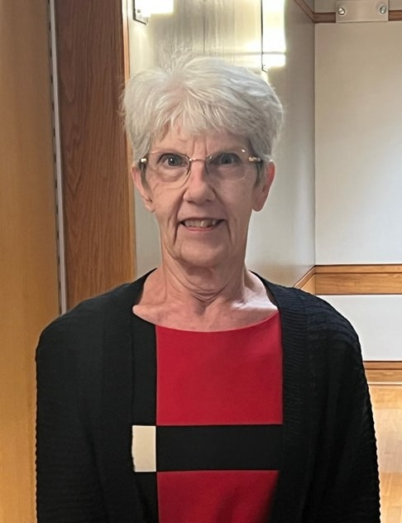
Departmental News in 2024
.
New Hires
Sixteen employees were hired in 2024 (1 captain, 1 patrol sergeant, 2 detectives, 6 police officers, 3 emergency communications officers, 1 emergency management specialist, 1 security officer, 1 administrative assistant, and 1 student assistant).
Promotions
Jack Campbell was promoted to Captain. Todd Carpenter, Bryce Ridgway, and Jason Felbush were promoted to Sergeant. Kendall Freeman and Eli Hodge were promoted to Detective.
Sixty Years at KU
Sandy Patchen celebrated 60 years of employment at the University of Kansas.
Administrative Associate Sandy Patchen at the
Employee Recognition Ceremony
Notes:
More icons available at:

Slide 37
Notes:
Detective has spoken with 5 other universities. Most of the Universities reported having a counter protest during Charlie Kirk’s talks. Incidents reported at those universities from nothing all they way to a full on riot that kept police on scene for 12 hours. UC Davis was the riot and it cost them around $400,000 in damages and manpower. Events ranged from 20 people all the say to 1000 showing up.

